Slide 1
Neuromend
By Tempest

Slide 2
Introduction
Client: Shri Rai
Supervisor: Fairuz Shiratuddin
Team Name: Tempest
Team Members:
Ary Bizar
Anopan Kandiah
Hannah Klinac
Alex Mlodawski
Bryan Yu
Project Name: Neuromend

Slide 3
Background

Slide 4
Problem

Slide 5
Solution

Slide 6
Challenges

Slide 7
World

Slide 8
Razer Hydra

Slide 9
Kinect

Slide 10
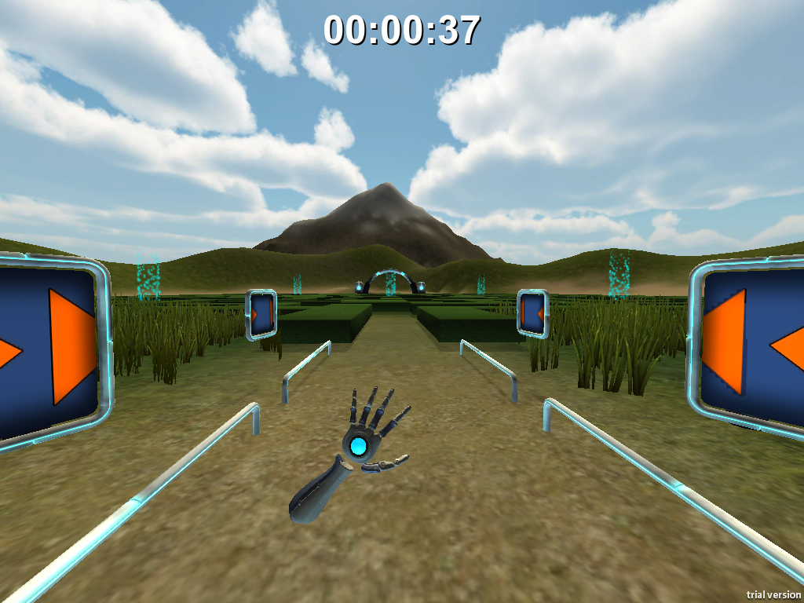
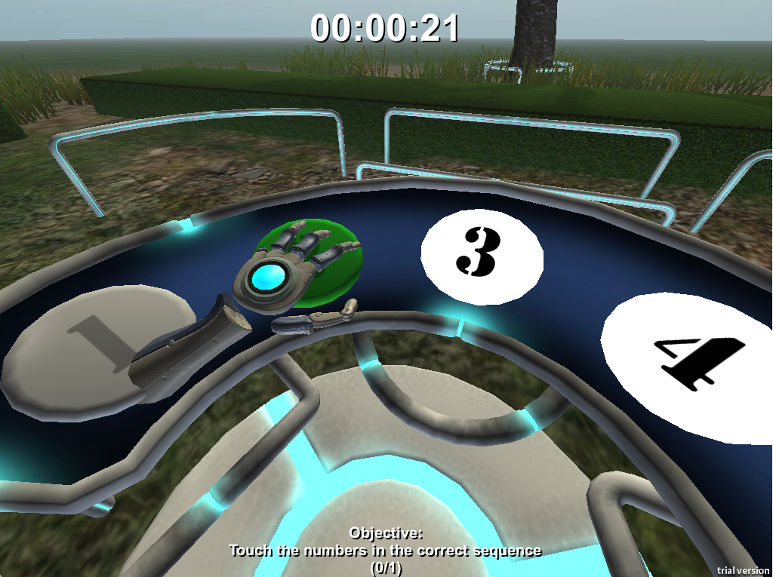
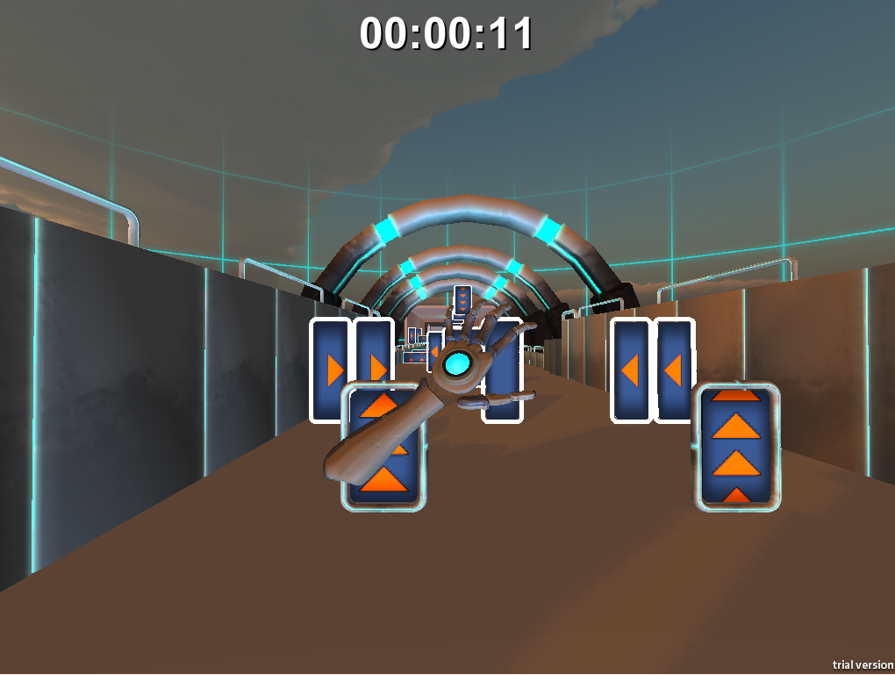
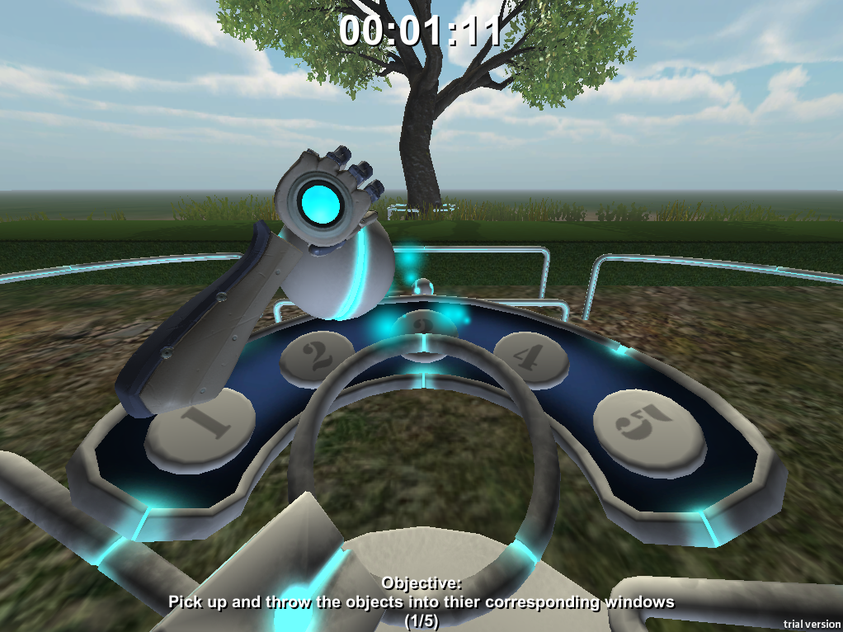
Leap Motion

Slide 11
Ary Twerking

Slide 12
Conclusion

